Slide 1
Gateway Clock
November 2018
Samer Darras
Barry Dropping

Slide 2
Agenda
IEEE 1588 Clock Types
Gateway Clock Overview
Time and Frequency Control Planes
Use Cases

Slide 3
IEEE 1588 PTP Clock Types
Today there are 4 different IEEE 1588 clock types.
Master Clock
Boundary Clock
Transparent Clock
Slave Clock
There are many different IEEE 1588 PTP profiles in use today including industry specific profiles for:
Telecommunications
Power Utilities
Enterprise
The current standard restricts PTP clocks to support a single protocol.
A Boundary Clock must for example support the same protocol (PTP Profile) on its input side and its output side

Slide 4
Gateway Clock – A New Clock Type
Industry requirements are expanding to require flexibility to support multiple evolving protocols for applications deployed today and for ones that will be required for the future
Modern clock systems are engineered to include multiple clock domains, and support multiple timing protocols
This gives rise to a new type of clock that can be described as a “Gateway Clock”

Slide 5
Gateway Clock Functional View
Timescale
Generation
Network Isolation
Timescale Distribution
GNSS Services (GPS, Galileo, GLONASS, Beidou)
Output Time and Frequency Services
Protocol Services
(NTP, PTP, etc.)
Protocol Services
(NTP, PTP, etc.)
Time Transfer
PHY Signals (SyncE, T1/E1, TOD, 1PPS, 10MHz, IRIG, etc.)
PHY Signals (SyncE, T1/E1, TOD, 1PPS, 10MHz, IRIG, etc.)
Test Point (1 PPS)

Slide 6
Gateway Clock – Multiple Control Planes
A Gateway Clock generates traceable time and frequency outputs:
Source for Time Control can be different than Frequency Control
The frequency control plane stabilizes the local oscillator to support enhanced time control
Frequency and Time control operate simultaneously
Traceability Control can mitigate path asymmetry on a PTP input reference
Traceability Control Plane
Phase/Time Control Plane
Frequency Control Plane

Slide 7
Gateway Clock Use Cases

Slide 8
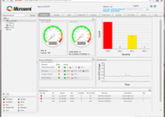
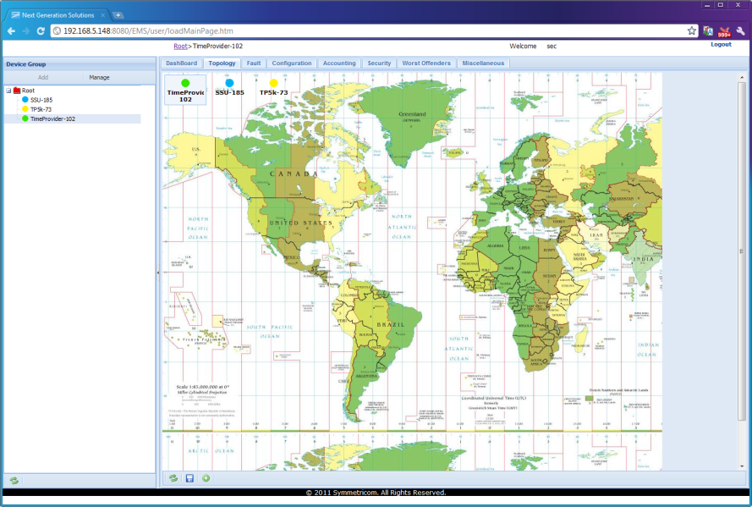
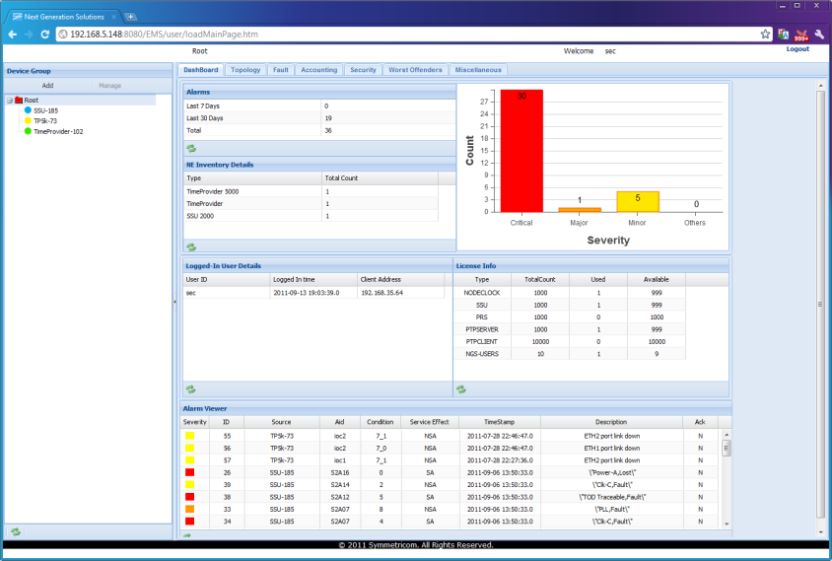
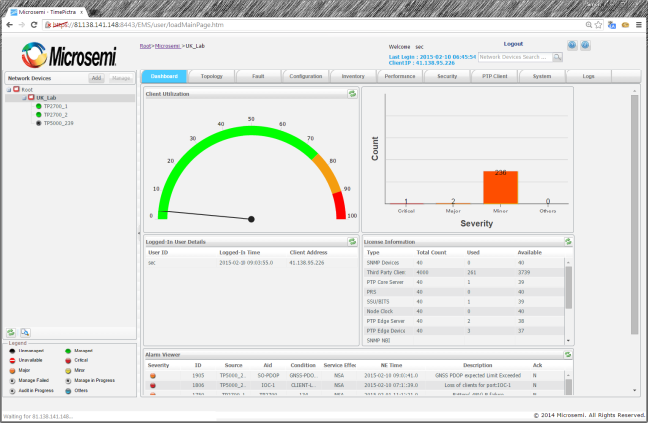
Communications Use Case for a Gateway Clock
In this example the Gateway clock is providing protocol translation from G.8275.2 to G.8275.1
Synchronization Management
Small Cells
Midhaul
PTP Grandmaster
Clock (PRTC)
Timescale
Generation
Network Isolation
Timescale Distribution
PTP G.8275.2
Gateway Clock
PTP G.8275.1
NB
Backhaul
Time Transfer
Backhaul
CPRI
Fronthaul
REC
Data Center
MTSO/CRAN
RE
Core
Aggregation
Edge

Slide 9
Data Center Use Case for a Gateway Clock
Many Data Centers are in Colocation environments where it is not possible to install GNSS
Advanced data centers require highly accurate stratum 1 level NTP
Stratum 2 NTP is generally not accurate enough for the today’s data center needs
In this case a Gateway Clock can be installed inside the Data Center
Highly accurate PTP can be received from a remote PTP master, and translated to NTP to serve the data center
PTP Grandmaster
Clock (PRTC)
Timescale
Generation
Network Isolation
Timescale Distribution
Gateway Clock
PTP
NTP
Time Transfer

Slide 10
Conclusion
A well designed “Gateway Clock” can provide timing protocol translation for flexible deployment
Gateway Clocks can select from multiple input reference types to establish independent Time and Frequency control planes
Many use cases can benefit from Gateway Clock functionality

Slide 11
Thank You

